Slide 1
SoCal/NorCal Chapters
of
Sister Cities International
Joint Meeting
Mary D. Kane
Mission San Miguel
January 30, 2016

Slide 2
Why?
“If we are going to take advantage of the assumption that all people want peace, then the problem is for people to get together and to leap governments – if necessary to evade governments – to work out not one method but thousands of methods by which people can gradually learn a little bit more of each other.”
President Dwight D. Eisenhower,
September 11, 1956
Why

Slide 3
Historical highlights
• 1950’s
• 1960’s
• 1970’s
• 1980’s
• 1990’s
• 2000’s
• 2010’s
Notes:
Just a few historical highlights!
In the 1950’s – High school teacher, Amanda Knecht, visited Brest, France in 1947. The city had been bombed extensively during a six week period in the Second World War. More than 5,000 sorties flew over the city before the occupying Germans finally surrendered. Knecht told her students in Denver about the devastation done by the war. Over the next year, Denver students raised more than $32,000 in nickels, pennies and dimes. The funds were presented to the City of Brest to be used to re-build the children’s wing of the Brest City Hospital. This relationship is strong to this day with student, municipal, cultural and business exchanges. Wine tastings are common now.
In the 1960’s – America did not always see people of different races break bread together. That was not the case with Sister Cities. During this turbulent decade, we were developing relationships in Africa, Asia and Latin America through student and municipal exchanges leading to substantial benefits for each community.
According to Gordon S. Clinton, chair of the Seattle – Kobe, Japan Sister City Committee in 1967, in the ten years of affiliation between Seattle WA and Kobe Japan, the dollar value of trade between the communities increased more than 300 percent – going from a 1957 value of $8.3 million to a 1967 value of $27.3 million.
This relationship is even stronger today. In June, 2015, Kobe Mayor Hisamoto met with numerous organizations and progressive thinkers–including Apple, startup investment organization “500 Startups,” and Seattle’s own Mayor Ed Murray. Mayors Hisamoto and Murray met for the signing of an agreement that will foster partnership and exchange between Seattle and Kobe’s aerospace and IT industries.
In the 1970’s – the Technical Assistance Program (TAP) sponsored by the US Department of State was started. The first was Hialeah FL and Managua, Nicaragua when they began a paramedic training program. Other programs included Atlanta Georgia and Montego Bay, Jamaica. At our first diplomatic Gala in 2015, the founder of this program was honored for his support of medical care in their sister city.
In the 1980’s – in 1979 St. Louis signed the first Chinese sister city relationship with Nanjing immediately following the reinstitution of diplomatic relations. Today there are close to 200 sister city relationships with China that have evolved from assistance to student exchanges and economic development. One of the most recent collaborations was the Sino – African Initiative sponsored by the Gates Foundation. US cities with partners in China and on the continent of Africa worked on health, water and education projects in their African sister city and then developed trade delegations to each city involved.
In 1985, President Xi Jingping made his first trip to the US on a sister state delegation to Muscatine, Iowa as part of an agricultural exchange. He returned in 2012 and signed a $4.3 billion agreement to buy soybeans from Iowa farmers.
In the 1990’s – Sports Diplomacy became evident during the first Sister Cities World Cup in Lexington, Kentucky. Just last year, the first Sister Cities International Bowl was held in Tuscaloosa, AL the home of the University of Alabama football team – the Crimson Tide with a professional American football team from their partner in Japan. Exploring economic development was highlighted by Toyota building their first plant in the US in 1998 in their sister city of San Antonio. This occurred ten years after San Antonio signed their sister city agreement with Kumamoto.
In the 2000’s – September 11, 2001 – the day that terrorists attacked the United States. The outpouring of support from our sister cities around the world was incredible. The sister cities with New York stepped up – Tokyo sent $5 million to the city and another $5 million to New York State. Jerusalem sent supplies for the first responders. The Mayor of Rome withdrew their bid for the 2012 Olympics and urged that New York City be awarded the honor. Prime Minister Tony Blair attended the services at St. Thomas for the missing 300 British citizens and all the others involved in the attack. The Sister Cities festival “UKinNY” was changed to “UKwithNY”. Exactly 45 years earlier, President Eisenhower convened the White House Conference on Citizen Diplomacy.
In the 2010’s - Now because of our new program “Measures that Matter” – we have the ability for your community to measure the economic impact sister cities have on your local community. Did you know that the average budget for a local program is $5357? Each partnership has an average of 533 participants in programs and events with an average local economic value of $73,333.
In 2014, there were 1123 inbound exchanges with 14153 participants and 944 outbound exchanges with 9889 participants. We have measured that the total number of volunteers in the US is 32876 and the total number of youth involved in SCI activities is 15288. The total number of events held throughout the US is 2316.
Through careful analysis, we can say that last year the total number of participants in Sister Cities activities was 1.13 million. And with a very conservative estimate, the direct effect on the US economy was $155 million. On the global economy it was $185 million.

Slide 4
Now: The Need for Action
Technology has made communication easier, however it has also made interpersonal relationships become more anonymous and less personal. Young people need “life-changing experiences” that can only happen through person-to- person educational and cultural exchanges.
• Unfortunately, war is still plaguing many communities throughout the world. The possibility of prosperous communities is intangible if there is no peace – more sister city relationships are needed in the Middle East, North Africa, and Latin America.
•
Why Us: Peace through People
Sister Cities International is the only organization in the U.S. with the responsibility of partnering U.S. communities with communities abroad to promote mutual respect, cooperation, and understanding through cultural, educational, economic, municipal, and humanitarian exchanges.

Slide 5
Need for Action (cont’d)
Our communities need long term, sustainable international economic development opportunities that sister city partnerships can provide.
Art and cultural exchanges build acceptance and appreciation for different cultures building the basis for mutually beneficial relationships.
Disasters occur in every country – and sister city partnerships facilitate quick, reliable assistance.

Slide 6
60th anniversary
Theme - Peace Through People
Campaign for Peace and Prosperity
  Sister Cities Day
  Increase on Public Awareness
    Communications Strategy
      Toolkits for members
      Assets
    Social Media Campaign
      Tell our stories
Notes:
STRATEGIC COMMUNICATIONS OBJECTIVES
The overarching goal of all integrated communications in 2015/2016 is to maximize awareness of the SCI 60th and leverage it to engage current and new audiences. To achieve this, communications must support the following objectives:
1. Keeping SCI members as the focus – as the main funders, consumers of and megaphones for our mission, messaging needs to cater to our majority audience.
a. Our network is our biggest asset
b. Our network will create the most momentum and be most inclined to spread our messaging and mission
c. It’s our grassroots opportunity
2. Showcase DC and other elected officials – As the host city for the 60th and as the city where SCI was born, SCI should leverage its connections to DC and other major cities to spread its messaging and engage.
a. Mayors and other officials have the reach, the following, the funding and the voice
b. As leaders, Mayors and other officials can easily create and mobilize action
3. Build broader public awareness:
a. Through expanding our issue areas and engaging new voices, we will build more public awareness of our mission, goals and anniversary
b. Target audiences
i. Globally minded people
ii. Community leaders
iii. The average person
iv. People who like travel and culture
v. Press – online and print
4. Fundraising
a. Leverage smart, tailored communications in order to raise more money for our mission
i. key stakeholders
ii. individual donors
iii. strategic corporate partners that share our values
5. Raise global awareness about the role of SCI in creating a better world
a. This is an overall underlying goal
MEGA THEMES
1. 60 YEARS OF PEACE THROUGH PEOPLE
2. 60 years of impact
3. 60 years of people, peace and prosperity
4. Recounting the past, imagining the future
5. Peace through people
6. Connecting people for shared prosperity and a more peaceful world
7. Connecting communities and connecting our future
MEGA MESSAGES
• Sister Cities International, started by President Eisenhower in 1956 is celebrating 60 years of peace through people
• Built on President Eisenhower’s original vision, Sister Cities International is celebrating 60 years of impact and connecting people around the globe for a more peaceful world.
• Sister Cities International is recounting its successes of the past 60 years and looking ahead towards contributing to a more prosperous and peaceful future
• Everyone has a role to play in maintaining peace around the world, in 2016 Sister Cities International is celebrating 60 years of global citizen action and looking forward to a future where the world’s citizens can come together in common ground.
• As SCI celebrates 60 years, people-to-people exchange has always been, and will continue to be, an essential first step to building mutual understanding and respect between nations and their citizens.
CALLS TO ACTION, TACTICS AND META-MESSAGES
All communications should include a specific call to action with messages directed towards constituencies:
To achieve this, communications must support the following objectives:
• OBJECTIVE: Keeping SCI members as the focus – as the main funders, consumers of and megaphones for our mission, messaging needs to cater to our majority audience.
o Our network is our biggest asset
o Our network will create the most momentum and be most inclined to spread our messaging and mission
o It’s our grassroots opportunity
• TACTICS
o Tailor messaging to members and use them as our overall megaphone
▪ Tool kits
▪ Digital engagement around rally moments
▪ Engagement around conferences and leadership meetings
▪ Empower with Data visualization to illustrate impact and reach of SCI network
• META-Messages
▪ Congratulations for helping Sister Cities International to reach 60 years of peace through people, it is you that drives our network to thrive and strive for a better, more peaceful and just world.
▪ Sister Cities International is celebrating 60 years, join us in helping to continue to build our vision for the future.
▪ Over the past 60 year’s you have helped Sister Cities International to shape President Eisenhower’s original dream of leveraging a citizen led network to create peace through building mutual understanding and respect between nations and their citizens, let's celebrate together.
▪ Together over the past 60 years we have worked across borders to find common ground, let’s plant the seeds together for a future of continued diplomatic growth.
• Sample Social Media Messaging
• OBJECTIVE: Showcase DC and other elected officials – As the host city for the 60th and as the city where SCI was born, SCI should leverage its connections to DC and other major cities to spread its messaging and engage.
o Mayors and other officials have the reach, the following and the voice
o Mayors and other officials can easily create and mobilize action
• TACTICS
o Tailor messaging to members and use them as our overall megaphone
▪ Tool kits for Mayoral proclamations
▪ Digital engagement around rally moments
▪ Engagement around conferences and leadership meetings
▪ Encourage civic leaders to write op-eds
▪ Empower key cities with data on impact and reach
• META-Messages
▪ Thanks for being an integral reason for the success of Sister Cities International over the past 60 years, it is you that drives our network to thrive and strive for a better, more peaceful and just world.
▪ Your City and its relationships with other cities around the world have been at the heart of continued cross cultural understanding, keep the momentum going strong and keep moving the needle on some of the world’s most pressing problems.
▪ Sister Cities International is celebrating 60 years, join us in helping to continue to build our vision for the future
▪ Over the past 60 year’s you have helped Sister Cities International to shape President Eisenhower’s original dream of leveraging a citizen led network to create peace through building mutual understanding and respect between nations and their citizens, let's celebrate together.
▪ Together over the past 60 years we have worked across borders to find common ground, let’s plant the seeds together for a future of continued diplomatic growth.
• Sample Social Media Messaging
o
• OBJECTIVE: Build broader public awareness:
o Through expanding our issue areas and engaging new voices, we will build more public awareness of our mission, goals and anniversary
o Target audiences
▪ Globally minded people
▪ Community leaders
▪ The average person
▪ People who like travel and culture
▪ Press – foreign policy, travel, parenting bloggers, local cities press, citiscope, diplomatic courier, NPR cities, Atlantic cities, Devex, cities today, buzzfeed piece
• TACTICS
o Tailor messaging to members and use them as our overall megaphone
▪ Creative press outreach to travel magazines, diplomatic publications, travel bloggers, foreign policy writers,
▪ Digital engagement around rally moments
▪ Engagement around conferences and leadership meetings
▪ Launch of the 60 days of impact to celebrate 60 years both on the blog and on social media, specifically Instagram which will end with our goals for the next 60 years
▪ Identify areas of interest for press and pitch them case study stories
▪ Facebook quiz on what would be your perfect sister city match
▪ More original op-eds on timely subjects
▪ Share data points at strategic moments
• META-Messages
▪ Should largely reflect Mega-messaging which has been curated for a broader audience
• Sample Social Media Messaging
▪
• OBJECTIVE: Fundraising
o Leverage smart, tailored communications in order to raise more money for our mission
▪ key stakeholders
▪ individual donors
▪ strategic corporate partners that share our values
• TACTICS
o Case for support widely distributed
o Sell pages of the annual Membership Directory
o Use Data points to tell our story of impact and reach and build a 1 pager from it as well as an infographic
o Build 1-2 strategic shared value partnerships
o Put together a YP and a normal host committee to raise funds for the 60th
o #GivingTuesday engagement (With a hopeful corporate match)
▪ Online campaign and contest to launch with crowdrise
▪ Small in-person fundraiser hosted by local board members
▪ Email campaign
o 60 days of giving campaign to launch mid-April with 60 days of impact (With a hopeful corporate match)
▪ Give 60 and get 6 friends to give 60
• META-Messages
o Congratulations for helping Sister Cities International to reach 60 years of peace through people, it is through your continued support that we can have been able to help drive our network to develop solutions for a more peaceful and just world.
o Sister Cities International is celebrating 60 years, join us in helping to continue to build our vision for the future by supporting SCI in this momentous year.
o Over the past 60 years you have helped Sister Cities International to shape President Eisenhower’s original dream of leveraging a citizen led network to create peace through building mutual understanding and respect between nations and their citizens, we hope you will donate 60 in the next 60 days in order to help us build a foundation to launch the next 60 years.
o Together over the past 60 years your support has enabled us to work across borders to find common ground, donate today and help us plant the seeds together for a future of diplomatic growth and continued peace.
o Everyone has a role to play in maintaining peace around the world, in 2016 Sister Cities International is celebrating 60 years of global citizen action and looking forward to a future where the world’s citizens can come together in common ground. The role you play in supporting SCI will help us to continue our work in creating a more peaceful and just world over the next 60 years.
o TBD messaging based on data points (Social Math, data telling the narrative of our value, our reach and the impact we make)
• Sample Social Media Messaging

Slide 8
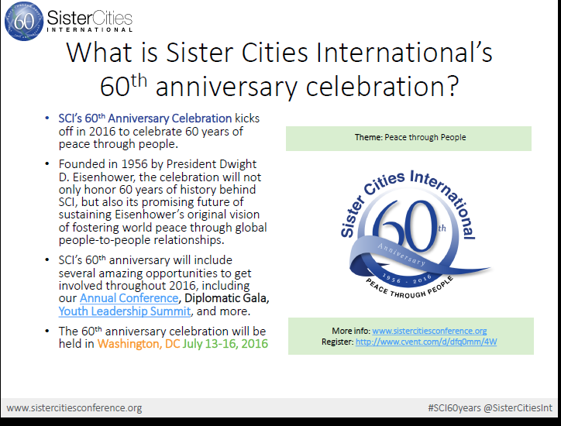

Slide 9
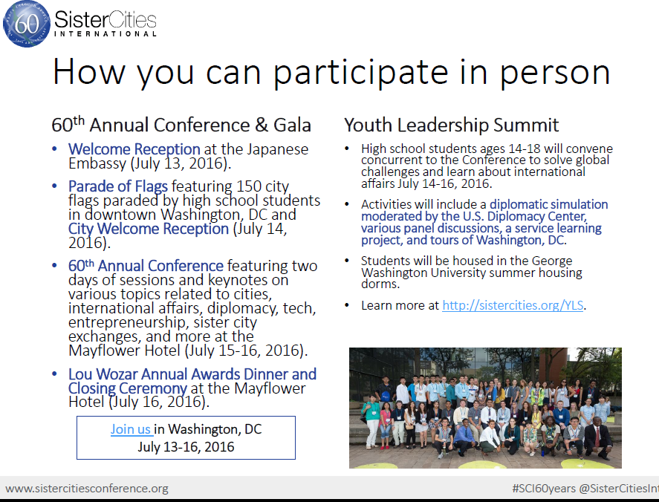

Slide 10
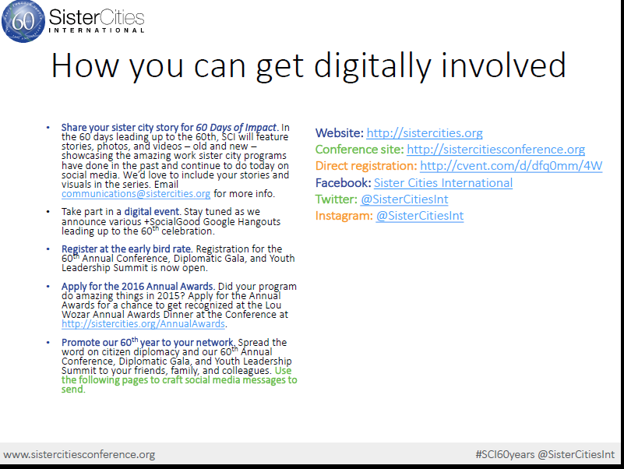

Slide 11
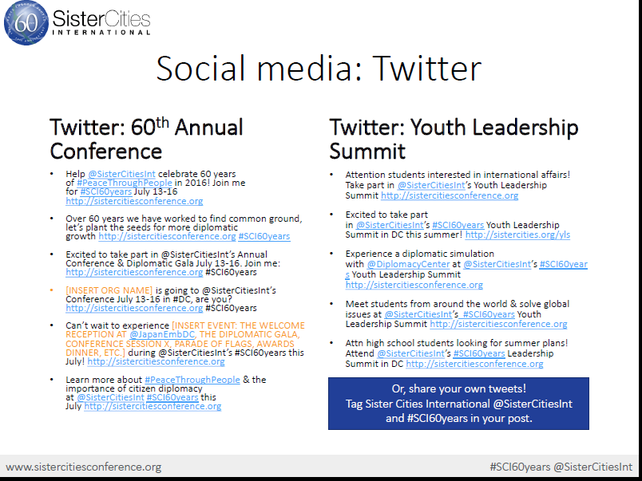

Slide 12
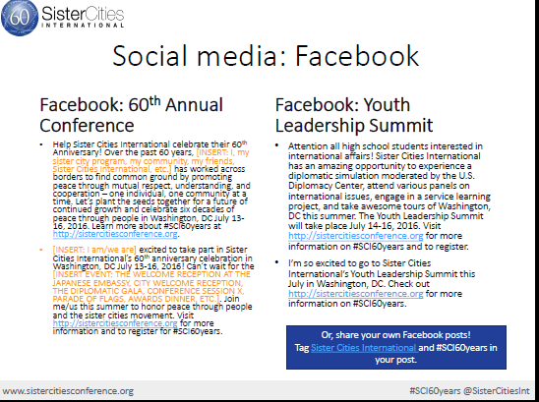

Slide 15
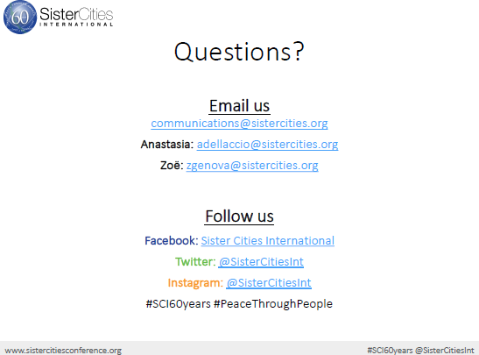

Slide 16
Events
12 Receptions and publicity events
Monthly highlights on designated “days”
  March 8th is International Women’s Day
US – Irish Sister Cities Delegation in April
  www.dublin2016.ie
Annual conference
Diplomatic Gala
Youth Leadership Summit

Slide 17
And one program everyone needs to use!!

Slide 18
Measures that Matter:
The Economic Impact of Your Sister City Relationships
Connect Globally. Thrive Locally.

Slide 19
Measures That Matter℠
Background
SCI was started 60 years ago by President Eisenhower.
Membership organization of 545 cities, counties and states with over 2,100 relationships in 145 countries.
Thousands of volunteers who work tirelessly to promote peace and understanding.
Funding for local, national and international programs consists for membership dues, government allocations and individual and foundation contributions.
Notes:
- SCI arose out of post WWII environment, hence the large number of partnerships in Germany, Japan, Italy, France
- Foundation as a peace-building organization;
- Role of cultural exchange and encouraging understanding is part of SCI’s DNA

Slide 20
Our Global Presence
Sister cities programs contribute over $525 million to the U.S. economy each year.
Most Sister City Partnerships by Region
  Europe 721
  Asia 674
  Americas 452
  Sub-Saharan Africa 145
  Middle East/North Africa 90
  Oceania 39
Most Sister City Partnerships by Country
  Mexico 202
  Japan 199
  China 164
  Germany 119
  France 102
  Italy 89
  Russia 77
  Taiwan 55
  South Korea 53
  Israel 52

Slide 21
National Presence
Most Sister City Partnerships by U.S. State
California 383
Florida 188
Texas 183
Illinois 106
Washington 78
Ohio 76
New York 65
North Carolina 64
Virginia 59
Maryland 58

Slide 22
Measures That Matter℠
Why?
Recession of 2008.
Need clarity on impact for city officials and supporters.
Need to measure economic performance.

Slide 23
Measures That Matter℠
Methodology
Conducted Needs Assessment with valueideas.
Developed Strategic Measures.
Classified Measures.
Created Data Collection Instrument.
Customized design of Measures That Matter℠ Model.
Planned and launched data collection.
Analyzed data.
Generated Report.
Presented to SCI Management.
Updated data, analyses and results.

Slide 24
Economic Impact of SCI Network: US
Travel related spending by inbound exchanges is $63.7 million, events hosted by sister cities around the U.S. contributed $56.5 million, and foreign host students added another $70.1 million, totaling $190.4 million in direct contributions to the U.S. economy.
While applying the multiplier effect of travel related contributions of indirect and induced spending, the economic impact on the U.S. economy is $430.8 million.

Slide 25
Economic Impact of SCI Network: U.S. (Cont.)
The cumulative in-kind contribution of SCI network volunteers to their communities is $94.8 million, making the total economic impact on the U.S. economy $525.7 million (USD).
The SCI network supports 1,641 direct jobs and a total of 3,715 jobs when indirect contributions are added.
The SCI network helps contribute $45.5 million towards payroll and about $29 million in federal, state, and local taxes.

Slide 26
The Economic Impact of SCI Network Exchanges: Non-U.S. and Global Economies
Travel related spending by outbound exchanges is $29.7 million, while host students add another $17.5 million, totaling $47.2 million (USD) in direct contribution by U.S. SCI members to the economies of international communities.
While applying a multipilier effect, similar to the U.S., of travel related contributions of indirect and induced spending, the total economic impact on non-U.S. economies is $106.8 million (USD).

Slide 27
The Economic Impact of SCI Network Exchanges: Non-U.S. and Global Economies (Cont.)
Using the average value of the global Purchase Price Parity (PPP) Index, the SCI Network’s direct contribution to non-U.S. economies is $18.3 billion and the total contribution is $41.5 billion.
The global direct impact of the SCI network is $237.6 million (USD) and the total impact is $537.7 million (USD).
When adjusted to the average value of the global PPP index, the direct SCI contribution to the global economy is $18.5 billion and total contribution is $41.9 billion.

Slide 28
Survey Result Highlights
The SCI network consists of 545 U.S. communities with 2,121 sister cities partnerships in 145 countries.
Approximately 50% of the cities within the SCI network have populations under 50,000.
Approximately 42% of sister city programs operate with a budget of less than $5,000 and 79% have a budget under $25,000.
Over 1/3 of the respondents received no financial support from city government outside of membership dues.
Based on the averages from the survey, over the past year, SCI network activities included:
  14,153 visitors from 1,123 inbound exchanges
  9,889 U.S. residents participating in 944 outbound exchanges
  32,876 volunteers involved throughout the U.S.
  15,288 youth involved
  2,316 total sister city events in the U.S. with participation from 1.13 million people

Slide 29
SCI’s U.S. Government Funding
The results of this study show that the Public-Private Partnership grant provided to SCI by the U.S. Department of State’s Bureau of Educational and Cultural Affairs is incredibly efficient. In 2015 the grant was $400,285.
SCI is perhaps one of the most effective organizations in establishing people-to-people diplomacy both in the U.S. and globally. The following tables summarize the average cost of engagement and the return on the Department of State grant dollar.
People-to-people diplomacy participants vs. U.S. Department of State Grant cost per participant
Volunteer - $12.20
Youth/student - $26.20
U.S. participant in local programs - $0.35
Global participant in sister city programs - $0.18

Slide 30
Economic Impact Table: Return on U.S. Department of State Grant Money
Return per Department of State Grant Dollar Value
U.S. Economy: Direct $476
U.S. Economy: Total $1,077
Non-U.S. Economies: Direct (USD) $118
Non-U.S. Economies: Direct (PPP) $45,791
Non-U.S. Economies: Total (USD) $267
Non-U.S. Economies: Total (PPP) $103,634
Global Economy: Direct (USD) $594
Global Economy: Direct (PPP) $46,267
Global Economy: Total (USD) $1,344
This study, however, does not take into consideration other direct services provided to the Department of State by SCI, such as assistance for Foreign Service Officers in establishing sister city partnerships, connecting its employees with municipal officials and volunteers, briefing International Visitors Leadership Program participants and other delegations, and promoting its programs and initiatives.

Slide 31
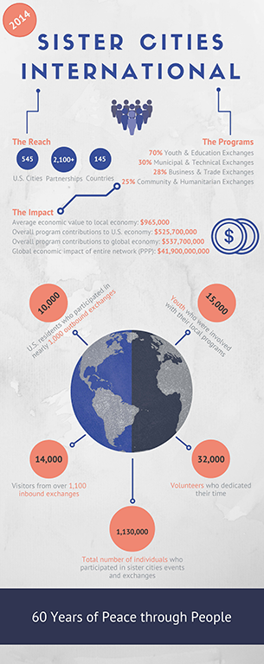

Slide 32
Conclusion
Difficult to measure.
Valuable for communities for not only peace but prosperity – trade happens everywhere.
A.T. Kearney Global Cities Index.
Membership benefit – use to show Governor, Mayor and City Council the value of sister cities.
Examples and Stories.
Notes:
Xi Jingping and Afghanistan

Slide 33
Please join us this year!
Happy 60th Anniversary to all sister cities!

